Slide 1


Pharmacy management system
CSET205 – SOFTWARE ENGINEERING
DEVANSH DAS – E20CSE227
SIDDHARTH PRATAP SINGH – E20CSE211
ADITYA SHARMA – E20CSE238

Slide 2
Introduction
In this day and age, pharmacies are the backbone of our society as the pandemic has made people rely more and more on pharmacies to remain healthy. So, pharmacies must manage themselves efficiently to stay functional in this competitive market. The goal of our team is to create an application that manages products, drugs, sorting of drugs, etc. so that the management of the store becomes easier like finding how much stock is left, available medicines, managing receipts, medicine prices, discounts, expiry dates, verifying whether the correct medicine is handed out, etc. The pharmacy administration system is a clinical shop system developed in NetBeans/Eclipse utilizing java programming language. This system supplies you the control over your drug store in the manner that what you can add or get rid of from the pharma store. This application allows the user to control their shop with ease and with greater efficiency. With this, the flow of medicines remains constant, and management of the shop becomes simpler.

Slide 3

Problem
In this day and age, pharmacies are the backbone of our society as the pandemic has made people rely more and more on pharmacies to remain healthy. So, pharmacies must manage themselves efficiently to stay functional in this competitive market. In order to do that pharmacists must have a system in place to manage their shop and remain relevant.

Slide 4
Solution
The goal of our team is to create an application that manages products, drugs, sorting of drugs, etc. so that the management of the store becomes easier like finding how much stock is left, available medicines, managing receipts, medicine prices, discounts, expiry dates, verifying whether the correct medicine is handed out, etc.

Slide 5
Software Requirements
WINDOWS 8 OR ABOVE
4 GB RAM
STABLE INTERNET CONNECTION

Slide 6
Tech/Resources utilized
JAVA
MYSQL

Slide 7

Stakeholders
Anurag Goswami : - Mentor/Instructor
Ashima Yadav : - Mentor/Instructor
Aditya Sharma : - Team Member
Siddharth Pratap Singh : - Team Member
Devansh Das : - Team Member

Slide 8
USERS
Pharmacists
Buyer

Slide 9
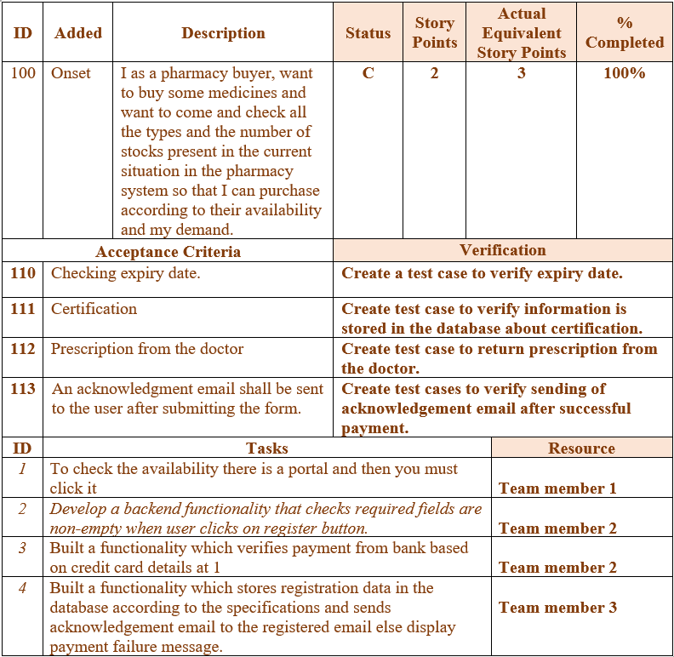
User stories Sprint 1

Slide 10
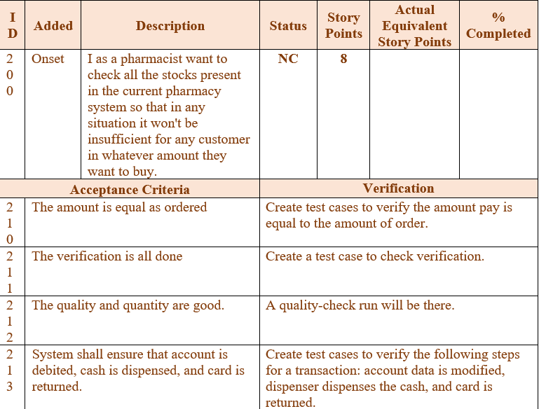
User
stories
Sprint 2

Slide 11
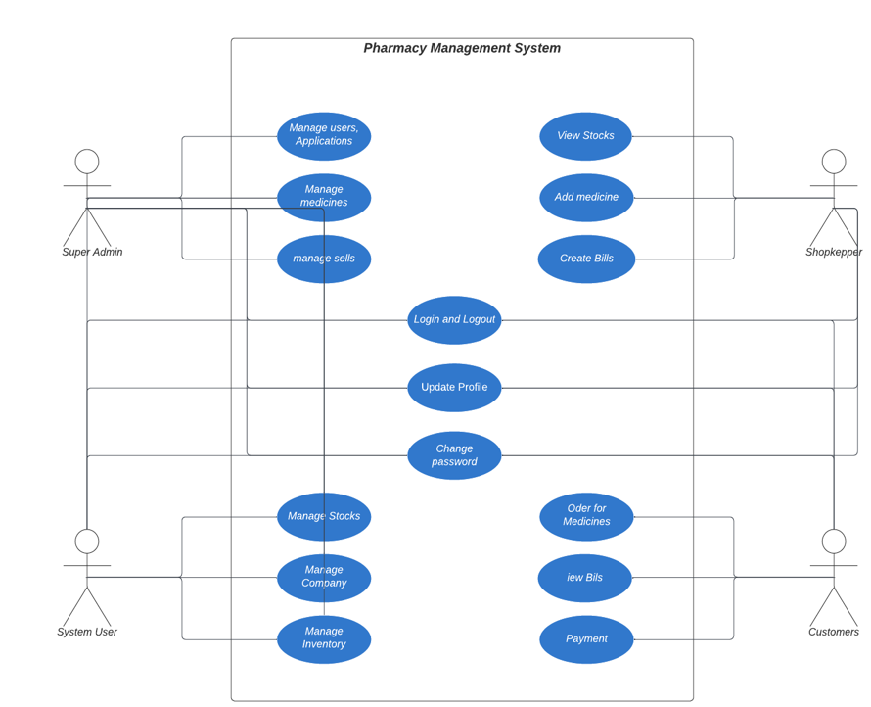
Use Case Diagram

Slide 12
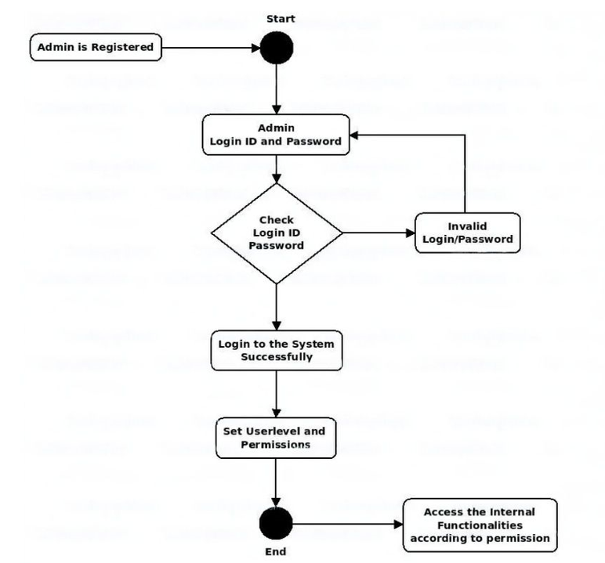
Activity Diagram

Slide 13
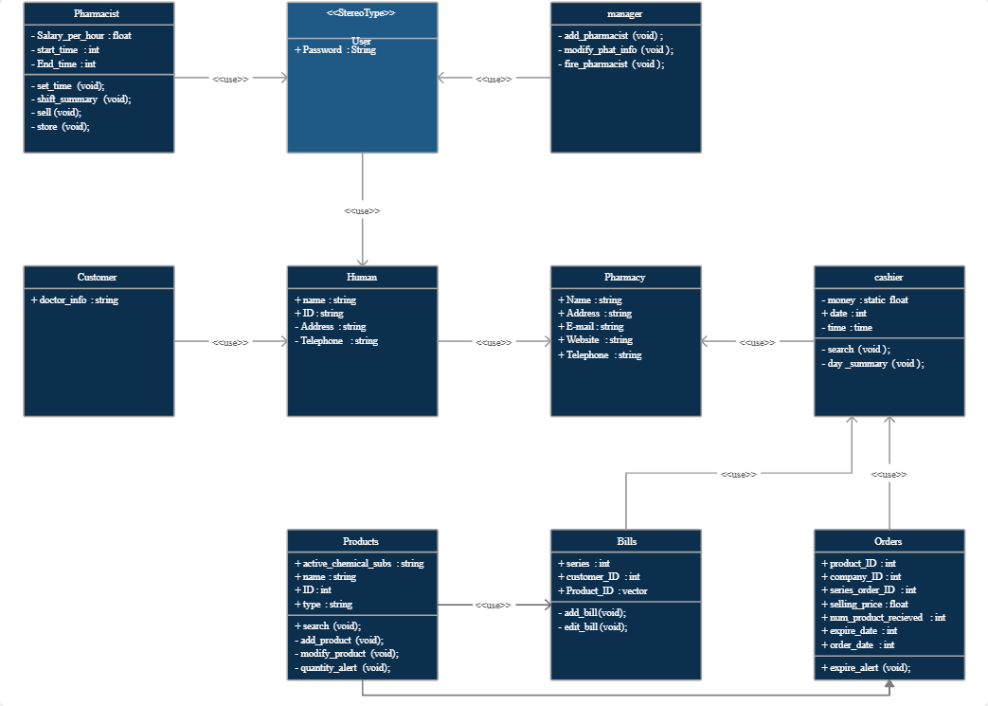
Class diagram

Slide 14
Thank You

